Slide 1
Lesson 8
Ratio and Proportion
Ratio fractional Situations

Slide 2
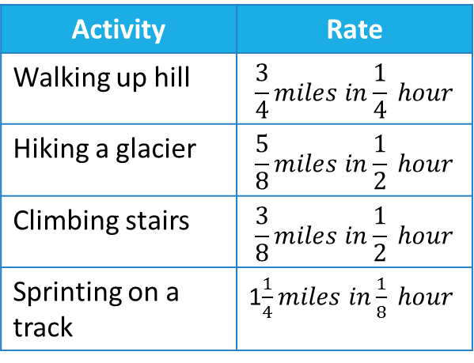
Lesson 8: Ratio Fractional Situations
Senona was timed walking up hill, hiking a glacier, climbing stairs, and sprinting on a track. To the right are her rates.
1. Compare the different rates and order them from slowest to fastest.
2. Which mathematical model(s) did you choose to create the comparisons?
Activity | Rate
Walking up hill | $$\frac{3}{4}miles in\frac{1}{4} hour$$
Hiking a glacier | $$\frac{5}{8}miles in\frac{1}{2} hour$$
Climbing stairs | $$\frac{3}{8}miles in\frac{1}{2} hour$$
Sprinting on a track | 1$\frac{1}{4}miles in\frac{1}{8} hour$

Slide 3
Lesson 8: Ratio Fractional Situations
Senona was timed walking up hill, hiking a glacier, climbing stairs, and sprinting on a track. To the right are her rates.
1. Compare the different rates and order them from slowest to fastest.
2. Which mathematical model(s) did you choose to create the comparisons?
Activity | Rate
Walking up hill | $$\frac{3}{4}miles in\frac{1}{4} hour$$
Hiking a glacier | $$\frac{5}{8}miles in\frac{1}{2} hour$$
Climbing stairs | $$\frac{3}{8}miles in\frac{1}{2} hour$$
Sprinting on a track | 1$\frac{1}{4}miles in\frac{1}{8} hour$

Slide 4
Lesson 8: Ratio Fractional Situations
To compare these rates it is typical to do the following. Use Worksheet 8.1.
3. Create a table of values.
4. Find a unit rate for each.
5. Graph each relationship.
Activity | Rate
Walking up hill | $$\frac{3}{4}miles in\frac{1}{4} hour$$
Hiking a glacier | $$\frac{5}{8}miles in\frac{1}{2} hour$$
Climbing stairs | $$\frac{3}{8}miles in\frac{1}{2} hour$$
Sprinting on a track | 1$\frac{1}{4}miles in\frac{1}{8} hour$

Slide 5
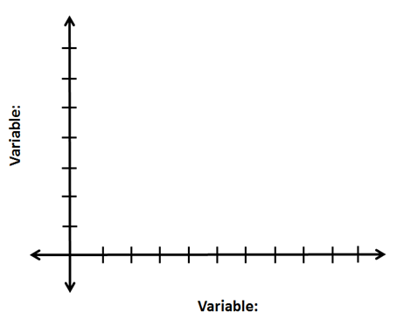
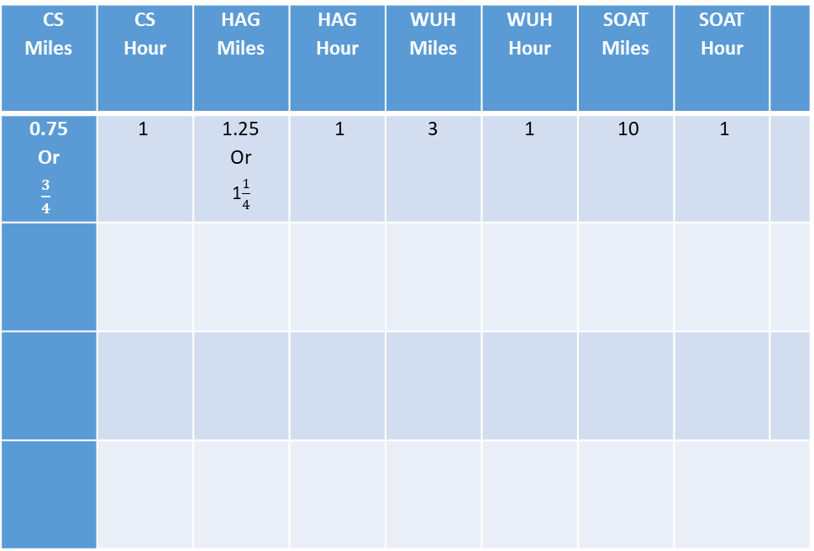
3. Create a table of values. 4. Find a unit rate for each. 5. Graph each relationship.
CS Miles | CS Hour | HAG Miles | HAG Hour | WUH Miles | WUH Hour | SOAT Miles | SOAT Hour
0.75 Or $\frac{3}{4}$ | 1 | 1.25 Or 1$\frac{1}{4}$ | 1 | 3 | 1 | 10 | 1

Slide 6
3. Create a table of values. 4. Find a unit rate for each. 5. Graph each relationship.
CS Miles | CS Hour | HAG Miles | HAG Hour | WUH Miles | WUH Hour | SOAT Miles | SOAT Hour
0.75 Or $\frac{3}{4}$ | 1 | 1.25 Or 1$\frac{1}{4}$ | 1 | 3 | 1 | 10 | 1

Slide 7
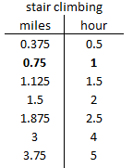
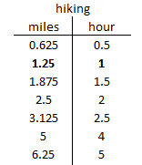
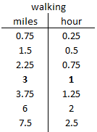
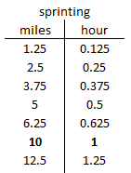
Lesson 8: Ratio Fractional Situations

Slide 8
Lesson 8.1 Worksheet:
Name:__________________________
Unit Rates
Ratio Tables
Graph
Notes:
Lesson 8.1 Worksheet

Slide 9
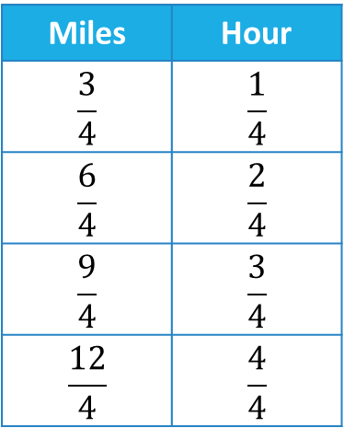
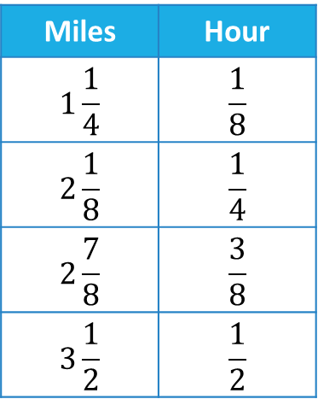
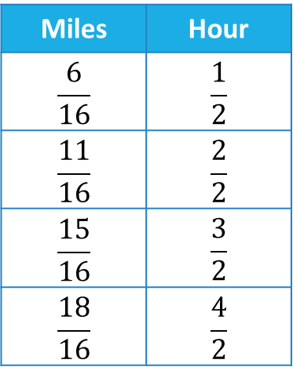
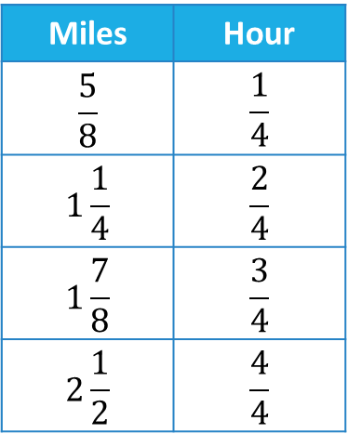
Lesson 8: Ratio Fractional Situations
6. Hugo is questioning whether the rates are really proportional. Here are his table of values. Graph all the data on one graph (Worksheet 8.2) and state which ones you agree are proportional and which ones are not and why?
Walking
Hiking
Stair Climbing
Sprinting
Miles | Hour
$$\frac{3}{4}$$ | $$\frac{1}{4}$$
$$\frac{6}{4}$$ | $$\frac{2}{4}$$
$$\frac{9}{4}$$ | $$\frac{3}{4}$$
$$\frac{12}{4}$$ | $$\frac{4}{4}$$
Miles | Hour
$$\frac{5}{8}$$ | $$\frac{1}{4}$$
$$1\frac{1}{4}$$ | $$\frac{2}{4}$$
$$1\frac{7}{8}$$ | $$\frac{3}{4}$$
$$2\frac{1}{2}$$ | $$\frac{4}{4}$$
Miles | Hour
$$\frac{6}{16}$$ | $$\frac{1}{2}$$
$$\frac{11}{16}$$ | $$\frac{2}{2}$$
$$\frac{15}{16}$$ | $$\frac{3}{2}$$
$$\frac{18}{16}$$ | $$\frac{4}{2}$$
Miles | Hour
$$1\frac{1}{4}$$ | $$\frac{1}{8}$$
$$2\frac{1}{8}$$ | $$\frac{1}{4}$$
$$2\frac{7}{8}$$ | $$\frac{3}{8}$$
$$3\frac{1}{2}$$ | $$\frac{1}{2}$$
Notes:
Use worksheet 8.2

Slide 10
Lesson 8.2 Worksheet:
Name:__________________________
Graph
Notes:
Lesson 8.1 Worksheet

Slide 11
Lesson 8: Ratio Fractional Situations
Martina says you don’t have to graph each set of values. She says the relationship within each ratio should have the same multiplicative value.
7. Explain what Martina means by showing an example and a non-example.
Walking
Hiking
Stair Climbing
Sprinting
Miles | Hour
$$\frac{3}{4}$$ | $$\frac{1}{4}$$
$$\frac{6}{4}$$ | $$\frac{2}{4}$$
$$\frac{9}{4}$$ | $$\frac{3}{4}$$
$$\frac{12}{4}$$ | $$\frac{4}{4}$$
Miles | Hour
$$\frac{5}{8}$$ | $$\frac{1}{4}$$
$$1\frac{1}{4}$$ | $$\frac{2}{4}$$
$$1\frac{7}{8}$$ | $$\frac{3}{4}$$
$$2\frac{1}{2}$$ | $$\frac{4}{4}$$
Miles | Hour
$$\frac{6}{16}$$ | $$\frac{1}{2}$$
$$\frac{11}{16}$$ | $$\frac{2}{2}$$
$$\frac{15}{16}$$ | $$\frac{3}{2}$$
$$\frac{18}{16}$$ | $$\frac{4}{2}$$
Miles | Hour
$$1\frac{1}{4}$$ | $$\frac{1}{8}$$
$$2\frac{1}{8}$$ | $$\frac{1}{4}$$
$$2\frac{7}{8}$$ | $$\frac{3}{8}$$
$$3\frac{1}{2}$$ | $$\frac{1}{2}$$
Notes:
Use worksheet 8.2

Slide 12
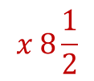
Lesson 8: Ratio Fractional Situations
Non-example
Example
Walking
Sprinting
Miles | Hour
$$\frac{3}{4}$$ | $$\frac{1}{4}$$
$$\frac{6}{4}$$ | $$\frac{2}{4}$$
$$\frac{9}{4}$$ | $$\frac{3}{4}$$
$$\frac{12}{4}$$ | $$\frac{4}{4}$$
Miles | Hour
$$1\frac{1}{4}$$ | $$\frac{1}{8}$$
$$2\frac{1}{8}$$ | $$\frac{1}{4}$$
$$2\frac{7}{8}$$ | $$\frac{3}{8}$$
$$3\frac{1}{2}$$ | $$\frac{1}{2}$$
$$x 3$$
$$x 10$$
$$x 3$$
$$x 8\frac{1}{2}$$
$$x 3$$
$x 7\frac{2}{3}$
$$x 3$$
$$x 7$$
Notes:
Use worksheet 8.2

Slide 13
Lesson 8: Ratio Fractional Situations
Lonzo also agrees you don’t have to graph each set of values. But he says the relationship between or across the ratios should have the same multiplicative value.
8. Explain what Lonzo means by showing an example and a non-example.
Walking
Hiking
Stair Climbing
Sprinting
Miles | Hour
$$\frac{3}{4}$$ | $$\frac{1}{4}$$
$$\frac{6}{4}$$ | $$\frac{2}{4}$$
$$\frac{9}{4}$$ | $$\frac{3}{4}$$
$$\frac{12}{4}$$ | $$\frac{4}{4}$$
Miles | Hour
$$\frac{5}{8}$$ | $$\frac{1}{4}$$
$$1\frac{1}{4}$$ | $$\frac{2}{4}$$
$$1\frac{7}{8}$$ | $$\frac{3}{4}$$
$$2\frac{1}{2}$$ | $$\frac{4}{4}$$
Miles | Hour
$$\frac{6}{16}$$ | $$\frac{1}{2}$$
$$\frac{11}{16}$$ | $$\frac{2}{2}$$
$$\frac{15}{16}$$ | $$\frac{3}{2}$$
$$\frac{18}{16}$$ | $$\frac{4}{2}$$
Miles | Hour
$$1\frac{1}{4}$$ | $$\frac{1}{8}$$
$$2\frac{1}{8}$$ | $$\frac{1}{4}$$
$$2\frac{7}{8}$$ | $$\frac{3}{8}$$
$$3\frac{1}{2}$$ | $$\frac{1}{2}$$
Notes:
Use worksheet 8.2

Slide 14


Lesson 8: Ratio Fractional Situations
Example
Non-example
Hiking
Stair Climbing
Miles | Hour
$$\frac{5}{8}$$ | $$\frac{1}{4}$$
$$1\frac{1}{4}$$ | $$\frac{2}{4}$$
$$1\frac{7}{8}$$ | $$\frac{3}{4}$$
$$2\frac{1}{2}$$ | $$\frac{4}{4}$$
Miles | Hour
$$\frac{6}{16}$$ | $$\frac{1}{2}$$
$$\frac{11}{16}$$ | $$\frac{2}{2}$$
$$\frac{15}{16}$$ | $$\frac{3}{2}$$
$$\frac{18}{16}$$ | $$\frac{4}{2}$$
$$\frac{6}{16}$$
$$x 2$$
$$x2$$
$$x 2$$
$$x2$$
$$\frac{12}{16}$$
$$≠$$
$$x 3$$
$$x3$$
$$x 3$$
$$x3$$
$$\frac{18}{16}$$
$$≠$$
$$x 4$$
$$x4$$
$$x 4$$
$$x4$$
$$\frac{24}{16}$$
$$≠$$
Notes:
Use worksheet 8.2

Slide 15
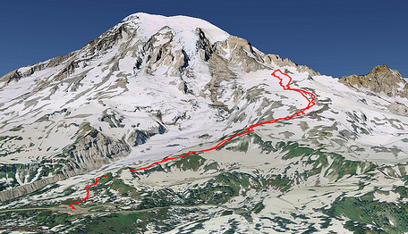
Lesson 8: Ratio Fractional Situations
Martina is hiking Mount Rainier in Washington. She starts at Paradise and is going to hike the 8.3 miles to Camp Muir. She just looked at her watch and she has hiked 2.5 miles in the past two hours.
9. Graph her rate.
10. If she continues at this rate, how many miles will she have traveled in 5 hours.
11. What is her unit rate?
12. Show where the following points are on the graph: (a) unit rate, (b) 2.5 miles, and (c) 5 hours.
13. Explain what each of these points mean.

Slide 16
Lesson 8: Ratio Fractional Situations
Martina is hiking Mount Rainier in Washington. She starts at Paradise and is going to hike the 8.3 miles to Camp Muir. She just looked at her watch and she has hiked 2.5 miles in the past two hours.
9. Graph her rate.
10. If she continues at this rate, how many miles will she have traveled in 5 hours.
11. What is her unit rate?
12. Show where the following points are on the graph: (a) unit rate, (b) 2.5 miles, and (c) 5 hours.
13. Explain what each of these points mean.
(a) 1.25 mph
(b) 2.5 miles in 2 hours
© 7.25 miles in 5 hours

Slide 17
Lesson 8: Ratio Fractional Situations
Martina is hiking Mount Rainier in Washington. She starts at Paradise and is going to hike the 8.3 miles to Camp Muir. She just looked at her watch and she has hiked 2.5 miles in the past two hours.
14. Create a formula that models her hiking rate.
15. At this rate, when will she arrive at Camp Muir?
16. From Camp Muir to the top of the mountain is much more dangerous and slow. Martina’s rate slows by 40%. How fast is she traveling now?
17. Create a formula for her new rate and use it to calculate when she will arrive at the summit, which is 4 miles from Camp Muir.

Slide 18
Lesson 8: Ratio Fractional Situations
Martina is hiking Mount Rainier in Washington. She starts at Paradise and is going to hike the 8.3 miles to Camp Muir. She just looked at her watch and she has hiked 2.5 miles in the past two hours.
14. Create a formula that models her hiking rate.
Hours * 1.25 = Total Miles
15. At this rate, when will she arrive at Camp Muir?
16. From Camp Muir to the top of the mountain is much more dangerous and slow. Martina’s rate slows by 40%. How fast is she traveling now?
17. Create a formula for her new rate and use it to calculate when she will arrive at the summit, which is 4 miles from Camp Muir.

Slide 19
Lesson 8: Review
Lonzo was hiking the Wonderland Trail. To the right is a graph showing has average rate while climbing.
18. Explain what the points (0, 0) means on the graph.
19. What is the point (1, r) if ‘r’ is the unit rate?
20. Explain with the unit rate means in this situation?
21. Why is this a proportional situation?
22. Senona says that any point (x, y) can give you the within relationship (y ÷ x). Justify whether this true or not.
Lonzo’s Hiking
6
Miles (miles)
3
$$\frac{7}{8}$$
$$\frac{4}{8}$$
$$\frac{8}{8}$$
$$\frac{12}{8}$$
$$\frac{16}{8}$$
Time (Hours)

Slide 20
Lesson 8: Review
Lonzo was hiking the Wonderland Trail. To the right is a graph showing has average rate while climbing.
18. Explain what the points (0, 0) means on the graph.
(0,0) means Lonzo has not started his hike. He is at the beginning of the trail.
19. What is the point (1, r) if ‘r’ is the unit rate?
“r” is approximately 3.5, because the relationship is proportional, if you go over to $\frac{8}{8}$ on the x-axis, and then up to the line, you are approximately at 3.5 on the y-axis.
20. Explain what the unit rate means in this situation?
The unit rate means Lonzo hikes at a rate of 3.5 mph.
21. Why is this a proportional situation?
Based on the graph: it is a straight line and intersects the origin.
Based on numbers: for every hour Lonzo hikes, he travels 3.5 miles.
22. Senona says that any point (x, y) can give you the within relationship (y ÷ x). Justify whether this is true or not.
This is true, because any time you solve (y ÷ x) your answer will be the unit rate of 3.5. This happens when the relationship is proportional.
Lonzo’s Hiking
6
Miles (miles)
3
$$\frac{7}{8}$$
$$\frac{4}{8}$$
$$\frac{8}{8}$$
$$\frac{12}{8}$$
$$\frac{16}{8}$$
Time (Hours)

