Slide 1
Lesson 4a.3
Number Lines
Absolute Value

Slide 2
Lesson 4a.3: Absolute Value
Max is at his house, which is 0 on the number line. One day Max bikes east (right) 4 miles and then rides the bus home with his bike. The next day he bikes west (left) 4 miles and then returns home on the bus.
How many miles has Max biked over the two days?
2. What is the distance he traveled east on his bike?
3. What is the distance he traveled west on his bike?
4. Use the number line below to plot his two bike rides.
5. How do we describe the similarities and difference between his two rides?
West
East
–20
–15
–10
–5
0
5
10
15
20
Notes:
Have students take notes in a math journal/notebook. They should redraw the number line.

Slide 3
Lesson 4a.3: Absolute Value
Max is at his house, which is 0 on the number line. One day Max bikes east (right) 4 miles and then rides the bus home with his bike. The next day he bikes west (left) 4 miles and then returns home on the bus.
How many miles has Max biked over the two days?
2. What is the distance he traveled east on his bike?
3. What is the distance he traveled west on his bike?
4. Use the number line below to plot his two bike rides.
5. How do we describe the similarities and difference between his two rides?
West
East
–20
–15
–10
–5
0
5
10
15
20
Notes:
Have students take notes in a math journal/notebook. They should redraw the number line.

Slide 4
Lesson 4a.3: Absolute Value
Each of Max’s rides are 4 miles. But because they are in different directions we need to use the positive (+) and negative (–) signs to differentiate between them. Going east is going to be positive and going west is going to be negative. The math term to describe distance is called absolute value. Absolute value is the distance from 0. The notation we use is $|4|$ and $|−4|$. Both are equal to 4.
6. If max travels 7 miles from home, what are the two possible points on the number line?
7. Describe Max’s distances using the absolute value notation.
West
East
–20
–15
–10
–5
0
5
10
15
20
Notes:
Have students take notes.

Slide 5
Lesson 4a.3: Absolute Value
Each of Max’s rides are 4 miles. But because they are in different directions we need to use the positive (+) and negative (–) signs to differentiate between them. Going east is going to be positive and going west is going to be negative. The math term to describe distance is called absolute value. Absolute value is the distance from 0. The notation we use is $|4|$ and $|−4|$. Both are equal to 4.
6. If max travels 7 miles from home, what are the two possible points on the number line?
7. Describe Max’s distances using the absolute value notation.
West
East
–20
–15
–10
–5
0
5
10
15
20
Notes:
Have students take notes.

Slide 6
Lesson 4a.3: Absolute Value
8. Create a vertical number line that extends from –12 to 12.
The surface of the water is at 0 m.
9. Draw each of the situations below on the graph and then place a point and the letter next to it to represent each location on your number line:
A – The sail of the boat is $6\frac{1}{2}$ m above the surface
B – The deck of the boat is 3 m above the surface
C – The bottom of the boat is $2\frac{1}{2}$ m below the surface
D – A diver is 4 m below the bottom of the boat
E – Treasure is $2\frac{1}{2}$ m below the diver
Notes:
Materials needed: graph paper (a blackline is available from the link below if no graph paper is available)
https://www.hand2mind.com/pdf/gridpaper.pdf

Slide 7
Lesson 4a.3: Absolute Value
Use your number line to answer each question.
10. Where is the diver located?
11. Which objects are the same distances away? Write them in absolute value notation.
12. What is at the lowest point?
13. Place a seagull at a spot that will have the same absolute value as the treasure. What is the point?
14. A group of fish are all within 2 m of the diver. Betsy says the depths of the fish are absolute values. Explain whether she is correct or not.
Notes:
Materials needed: graph paper (a blackline is available from the link below if no graph paper is available)
https://www.hand2mind.com/pdf/gridpaper.pdf

Slide 8
Lesson 4a.3: Absolute Value
Use your number line to answer each question.
10. Where is the diver located?
11. Which objects are the same distances away? Write them in absolute value notation.
12. What is at the lowest point?
13. Place a seagull at a spot that will have the same absolute value as the treasure. What is the point?
14. A group of fish are all within 2 m of the diver. Betsy says the depths of the fish are absolute values. Explain whether she is correct or not.
Notes:
Materials needed: graph paper (a blackline is available from the link below if no graph paper is available)
https://www.hand2mind.com/pdf/gridpaper.pdf

Slide 9
Lesson 4a.3: Absolute Value
Use your number line to answer each question.
10. Where is the diver located?
11. Which objects are the same distances away? Write them in absolute value notation.
12. What is at the lowest point?
13. Place a seagull at a spot that will have the same absolute value as the treasure. What is the point?
14. A group of fish are all within 2 m of the diver. Betsy says the depths of the fish are absolute values. Explain whether she is correct or not.
Notes:
Materials needed: graph paper (a blackline is available from the link below if no graph paper is available)
https://www.hand2mind.com/pdf/gridpaper.pdf

Slide 10
Lesson 4a.3: Absolute Value
Complete Worksheets 3.1a and 3.1b.
For each situation you will either write a context (regarding sea level), create a number line and represent the points, or write the points with absolute value notation.
I rode my bike 5 miles west today. I rode my bike 5 miles east yesterday.

Slide 11
Worksheet 4a.3a
Context | Number Line | Absolute Value Notation
A seagull could be at 5 ½ meters above sea level and dives to a fish at 5 ½ meters below sea level.
A ship deck and hull (bottom of the ship) could be a distance of 4 meters from sea level.
A sailfish can start at 2.25 meters below sea level and jump up to 2.25 meters out of the water.
15a.
15b.
16a.
16b.
17a.
17b.
18a.
18b.
–5
0
5
19a.
19b.
–5
0
5

Slide 12
Worksheet 4a.3a
Context | Number Line | Absolute Value Notation
A seagull could be at 5 ½ meters above sea level and dives to a fish at 5 ½ meters below sea level.
A ship deck and hull (bottom of the ship) could be a distance of 4 meters from sea level.
A sailfish can start at 2.25 meters below sea level and jump up to 2.25 meters out of the water.
15a.
15b.
16a.
16b.
17a.
17b.
18a.
18b.
–5
0
5
19a.
19b.
–5
0
5

Slide 13
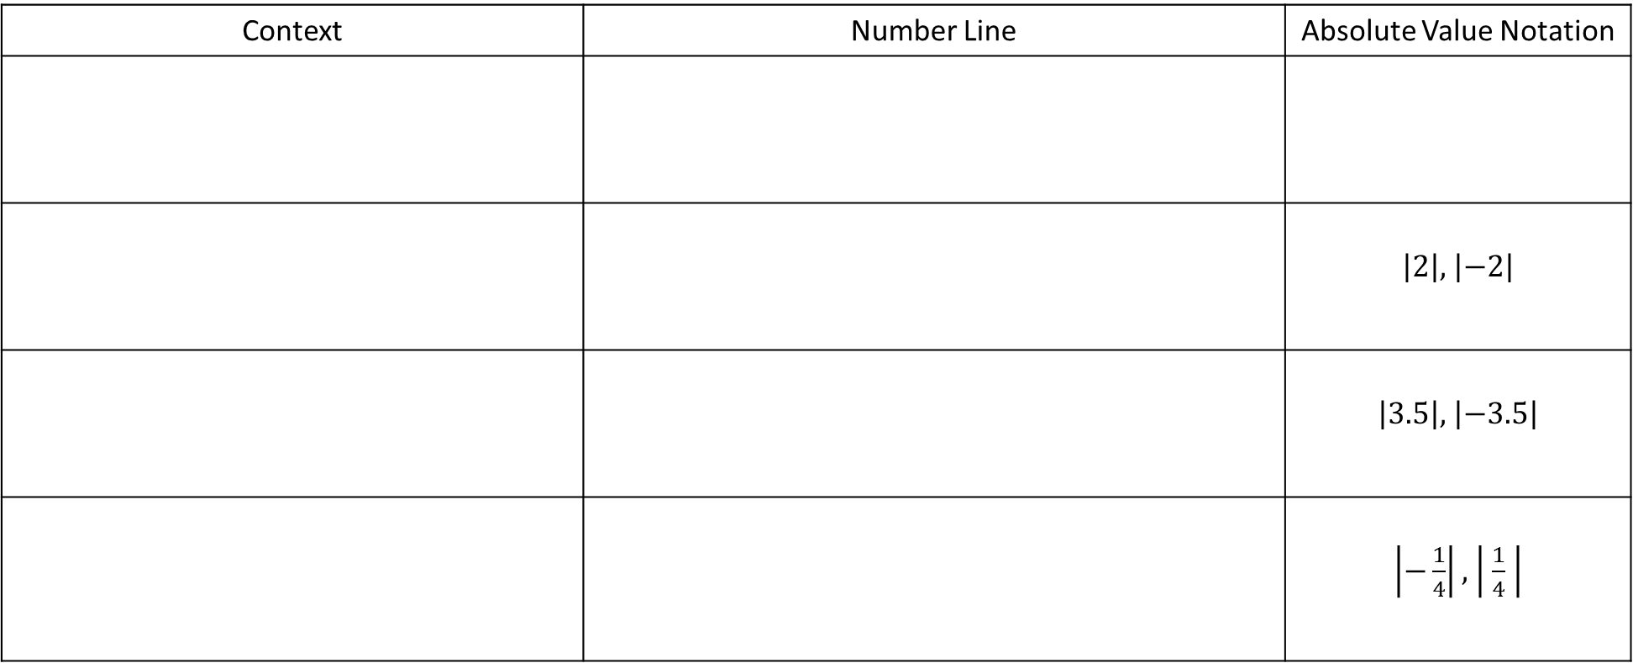
Worksheet 4a.3b
Context | Number Line | Absolute Value Notation
 |  | $\left|2\right|,$ $\left|−2\right|$
 |  | $\left|3.5\right|,$ $\left|−3.5\right|$
 |  | $\left|−\frac{1}{4}\right|,$ $\left| \frac{1}{4} \right|$
20a.
20b.
–5
0
5
21a.
21b.
22a.
22b.
23a.
23b.

Slide 14
Worksheet 4a.3b
Context | Number Line | Absolute Value Notation
 |  | $\left|2\right|,$ $\left|−2\right|$
 |  | $\left|3.5\right|,$ $\left|−3.5\right|$
 |  | $\left|−\frac{1}{4}\right|,$ $\left| \frac{1}{4} \right|$
20a.
20b.
–5
0
5
21a.
21b.
22a.
22b.
23a.
23b.

Slide 15
Lesson 4a.3: Review
24. What is the definition of absolute value?
25. Place two non-integer points on the number line that represent absolute value.
26. Write the two values from above using absolute value notation.
27. Write a statement about traveling east (right) and west (left) that matches your points.
28. Which of the following statements are true about absolute value? Explain why.
a. The same distance away from any point.
b. The distance 10 less than 0.
West
East
–20
–15
–10
–5
0
5
10
15
20

