Slide 1
Lesson 4a.5
Number Lines
Opposites and Context

Slide 2
Lesson 4a.5: Opposites and Context
Warmup: Write the answers to each of the following.
5 + (+2) =
5 + (+1) =
5 + (0) =
5 + (–1) =
5 + (–2) =
5 + (–3) =
5 + (–4) =
5 + (–5) =

Slide 3
Lesson 4a.5: Opposites and Context
Warmup: Write the answers to each of the following.
5 + (+2) =
5 + (+1) =
5 + (0) =
5 + (–1) =
5 + (–2) =
5 + (–3) =
5 + (–4) =
5 + (–5) =

Slide 4

Lesson 4a.5: Opposites and Context
State the opposite of each of the following situations You can use the number line if it is helpful:
25 degrees above zero.
2. A loss of $28.
3. $−17$meters from sea level.
4. 22.3 miles East.
–20
–15
–10
–5
0
5
10
15
20

Slide 5
Lesson 4a.5: Opposites and Context
State the opposite of each of the following situations You can use the number line if it is helpful:
25 degrees above zero.
2. A loss of $28.
3. $−17$meters from sea level.
4. 22.3 miles East.
–20
–15
–10
–5
0
5
10
15
20

Slide 6
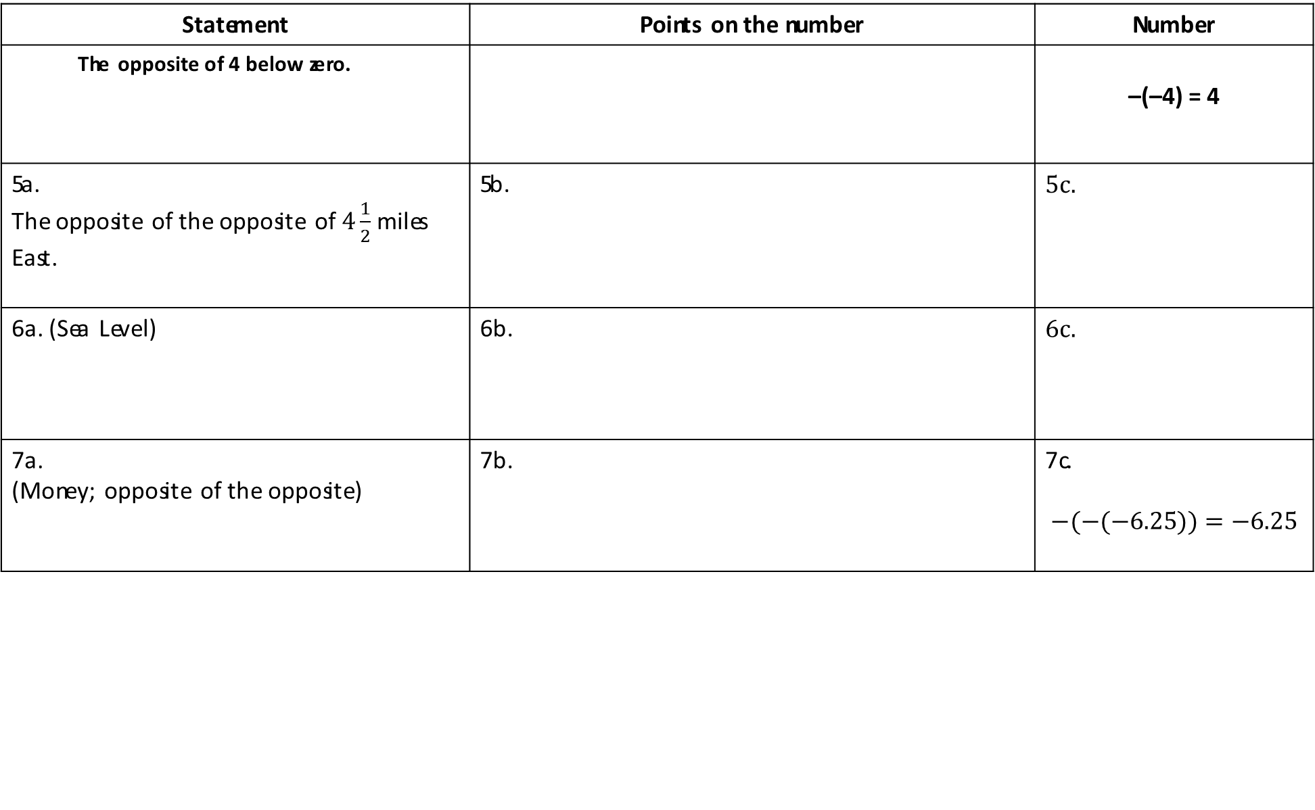
Worksheet 4a.5.1
Statement | Points on the number | Number
The opposite of 4 below zero. |  | –(–4) = 4
5a. The opposite of the opposite of $4\frac{1}{2}$ miles East. | 5b. | 5c.
6a. (Sea Level) | 6b. | 6c.
7a. (Money; opposite of the opposite) | 7b. | 7c. $$−(−(−6.25))=−6.25$$
E.g.
–5
0
5
–5
0
5
Notes:
Worksheet 5.1

Slide 7
Worksheet 4a.5.1
Statement | Points on the number | Number
The opposite of 4 below zero. |  | –(–4) = 4
5a. The opposite of the opposite of $4\frac{1}{2}$ miles East. | 5b. | 5c.
6a. (Sea Level) | 6b. | 6c.
7a. (Money; opposite of the opposite) | 7b. | 7c. $$−(−(−6.25))=−6.25$$
E.g.
–5
0
5
–5
0
5
Notes:
Worksheet 5.1

Slide 8
Lesson 4a.5: Opposites and Context
As we have discussed, every number has an opposite number on the number line that is the same distance from 0, but in the opposite direction. We could say it is has the opposite magnitude or size. Magnitude allows us to order similar units or objects.
So, 6° is less than 7°,
but –7° is less than –6°.
8. Let’s try an example. Explain to your neighbor why 9 away from 0 could be less than, or more than, 8 away from 0.
Write this down in your notes: 9 is above 8 on the number line, but –8 is above –9 on the number line. Or 9 degrees is warmer than 8 degrees, but –8 degrees is warmer than –9 degrees.
10
7
6
1 less
0
–6
1 less
–7
–10
Temperature (C°)
Notes:
Have students take notes in their math journal/notebooks.

Slide 9
Lesson 4a.5: Opposites and Context
9. Place each of the following statements as a point on the appropriate number line.
10. Order each number from greatest to least.
a. | 2.5 feet above sea level | e. | –1.25 feet
b. | 3 ½ feet below sea level | f. | 4 ½ feet above sea level
c. | – 4 ½ feet | g. | 3 ½ feet
d. | 1.25 feet | h. | 5.2 feet above sea level
Sea Level
Notes:
Students can draw their own vertical number lines or this slide can be printed as a worksheet.

Slide 10
Lesson 4a.5: Opposites and Context
9. Place each of the following statements as a point on the appropriate number line.
10. Order each number from greatest to least.
a. | 2.5 feet above sea level | e. | –1.25 feet
b. | 3 ½ feet below sea level | f. | 4 ½ feet above sea level
c. | – 4 ½ feet | g. | 3 ½ feet
d. | 1.25 feet | h. | 5.2 feet above sea level
Sea Level
Notes:
Students can draw their own vertical number lines or this slide can be printed as a worksheet.

Slide 11
Lesson 4a.5: Opposites and Context
11. Write four statements that use a rational number that is not an integer for profit or loss, place that point on the appropriate number line, and order them from greatest to least. Two numbers must be more than 0 and two numbers must be less than 0.
a.
b.
c.
d.
Profit/Loss
Notes:
Students can draw their own vertical number lines or this slide can be printed as a worksheet.

Slide 12
Lesson 4a.5: Opposites and Context
11. Write four statements that use a rational number that is not an integer for profit or loss, place that point on the appropriate number line, and order them from greatest to least. Two numbers must be more than 0 and two numbers must be less than 0.
a. Juan won $4.50.
b. Alanna received $2.25 from the tooth fairy.
c. Justin owes Ian $1.25.
d. Dylan lost $4.25.
Profit/Loss
Notes:
Students can draw their own vertical number lines or this slide can be printed as a worksheet.

Slide 13
Worksheet 4a.5.2
12. Temperature
a. Statement:
b. Order
13. Profit and Loss
a. Statement:
b. Order
14. Sea Level
a. Statement:
b. Order
5
$25
5,000
0
0
0
–5
–$25
–5,000
Temperature (C°)
Profit/Loss
Sea Level
Notes:
Print this page for students.

Slide 14
Worksheet 4a.5.2
12. Temperature
a. Statement: It was 1.5 degrees Celsius outside today.
b. Order: A, B, C
13. Profit and Loss
a. Statement: I lost $5 on a bet.
b. Order: A, B, C
14. Sea Level
a. Statement: The submarine was 3,000 meters below sea level.
b. Order: A, B, C
5
$25
5,000
0
0
0
–5
–$25
–5,000
Temperature (C°)
Profit/Loss
Sea Level
Notes:
Print this page for students.

Slide 15
Lesson 4a.5: Review
15. What is similar and what is different between absolute value and opposite numbers?
16. What is the opposite of the following statement: 5.2 miles to the east (to the right on a map).
17. Abigail ordered the following from the smallest profit to the largest profit. If wrong, how would you order them?
a. gain of $6 b. $6 ½ c. loss of $7. d. – $15 e. gain of $17
18. Andrea says that 12 away from 0 is always greater than 10 away from zero. Provide an example with profit and loss that agrees or disagrees with Andrea.
19. What does magnitude mean in regards to numbers on the number line?
Profit/Loss
Notes:
15. Similarity: both describe numbers that are the same distance from 0. Difference: absolute value is the distance away from 0 and opposite numbers have opposite signs.

Slide 16
Lesson 4a.5: Review
15. What is similar and what is different between absolute value and opposite numbers?
Opposite numbers would be a positive and negative of the same number (ex. 5, -5)
Absolute value is the distance a number is from zero (ex. 5 and -5 are both 5 away from zero so both of their absolutes values equal 5.)
16. What is the opposite of the following statement: 5.2 miles to the east (to the right on a map).
5.2 miles to the west.
17. Abigail ordered the following from the smallest profit to the largest profit. If wrong, how would you order them?
a. gain of $6 b. $6 ½ c. loss of $7. d. – $15 e. gain of $17
Wrong, they should be ordered E, B, A, C, D
18. Andrea says that 12 away from 0 is always greater than 10 away from zero. Provide an example with profit and loss that agrees or disagrees with Andrea.
I agree in the case of profit/loss, because having $12 is greater than having $10 and owing someone $12 is greater than owing them $10.
19. What does magnitude mean in regards to numbers on the number line?
The higher, or more to the right, a number is on a number line, the greater the magnitude.
Profit/Loss
Notes:
15. Similarity: both describe numbers that are the same distance from 0. Difference: absolute value is the distance away from 0 and opposite numbers have opposite signs.

Slide 17
Lesson 4a.5: Review
Word Bank
Opposite Absolute Value Less than Greater Than
Magnitude Distance
20. Use as many words from the word bank as you can to describe what is happening in the following situations:
The temperature increased 8 degrees and it is was 4 below zero.
b. I had $7.50 in my bank account and I earned $7.50.
c. A diver is 12 meters from sea level and increased 16 meters.
d. The temperature changes from 14 below zero to 7 below zero.
e. I was $16 dollars in debt, but earned a $32.
f. A seagull was at 4 ½ feet in dove 9 feet.

Slide 18
Lesson 4a.5: Review
Word Bank
Opposite Absolute Value Less than Greater Than
Magnitude Distance
20. Use as many words from the word bank as you can to describe what is happening in the following situations:
The temperature increased 8 degrees and it is was 4 below zero.
The temperature is now the opposite of 4 below zero.
b. I had $7.50 in my bank account and I earned $7.50.
I increased the magnitude of my bank account.
c. A diver is 12 meters from sea level and increased 16 meters.
The diver changed their distance from sea level from 12 meters below sea level to 4 meters above sea level.
d. The temperature changes from 14 below zero to 7 below zero.
7 degrees below zero is greater than 14 degrees below zero.
e. I was $16 dollars in debt, but earned a $32.
Owing $16 and having $16 has the same absolute value.
f. A seagull was at 4 ½ feet and dove 9 feet.
Diving 9 feet puts the seagull 4 and a half feet below sea level. 4 and a half feet below sea level is less than 4 and a half feet above sea level.

Slide 19
Lesson 4a.5: Review
21. Order the following from least to greatest:
$−3, 4, −4, 3$
b. $\left|−5\right|, 6, \left|3.9\right|, −3.9, 4$
c. $−2.4, −2.7, −1.3$
d. $0, 2\frac{1}{7}, −2\frac{1}{8},2\frac{1}{8}, −2\frac{1}{7}$
22. Andrea wanted to plot $−3\frac{1}{4}$ on a number line. She counted 3 tick marks to the left of 0 and moved $\frac{1}{4}$ to the right. What number did she actually plot and explain how she should fix her mistake.
Notes:
This page can be printed for students.

Slide 20
Lesson 4a.5: Review
21. Order the following from least to greatest:
$−3, 4, −4, 3$
-4, -3, 3, 4
b. $\left|−5\right|, 6, \left|3.9\right|, −3.9, 4$
-3.9, 3.9, 4, 5, 6
c. $−2.4, −2.7, −1.3$
-2.7, -2.4, -1.3
d. $0, 2\frac{1}{7}, −2\frac{1}{8},2\frac{1}{8}, −2\frac{1}{7}$
-2$\frac{1}{7}, −2\frac{1}{8}, 0, 2\frac{1}{8}, 2\frac{1}{7}$
22. Andrea wanted to plot $−3\frac{1}{4}$ on a number line. She counted 3 tick marks to the left of 0 and moved $\frac{1}{4}$ to the right. What number did she actually plot and explain how she should fix her mistake.
She plotted $−2\frac{3}{4}$, to correct her mistake she would count 3 tick marks to the left and then move $\frac{1}{4}$ more to the left.
Notes:
This page can be printed for students.

