Slide 1
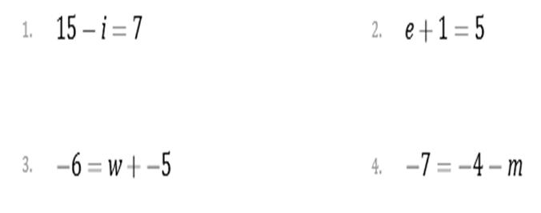
Module 7 – 5.1 Solving Equations: Isolating the Variable – Addition and Subtraction

Slide 2
Module 7 – 5.1 Solving Equations: Isolating the Variable – Addition and Subtraction

