Slide 1
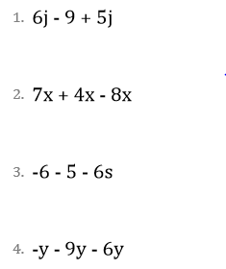
Module 7 – 5.5 Solving Linear Expressions

